Slide 1
Node-Red Weather Monitoring System
Karthikeyan K 2018103549
Jim Tony B 2018103543
Bharath S 2018103519
Dhanush Kumar S 2018103022

Slide 2
Introduction
In this we designed and implemented an IoT (Internet of Things) platform for analysis of weather conditions using the Node-RED platform.
Node-RED allows us to wire together nodes to create flows, which carry out our programming task.
We used the openweathermap node-red node that gets weather report from OpenWeatherMap.
An API key is required to use this node.

Slide 3
Flow 1
Flow #1
We visualize in real time, chart graphs (temperature, time), (humidity, time), (atmospheric pressure, time).
Every 2 hours the system writes a short description of the current weather conditions (eg fog, rain, etc.) as they are taken from https://openweathermap.org.

Slide 4
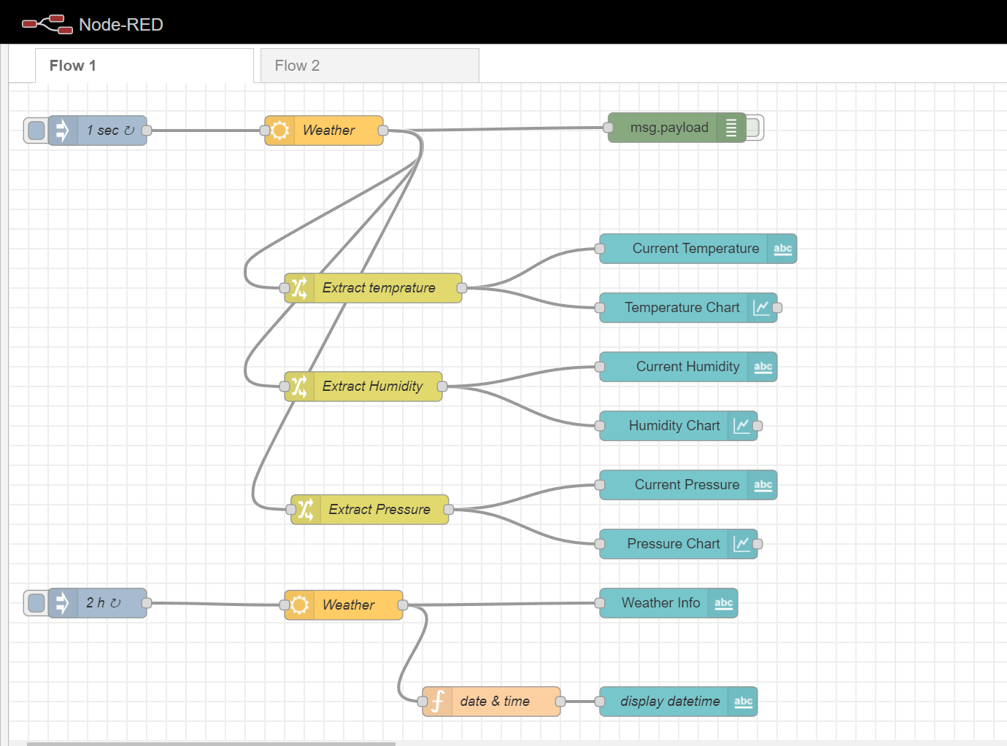
Flow 1

Slide 5
Flow 2
Flow #2
The code stores in a database(SQLite) from time to time (every 5 seconds) the temperature, humidity and atmospheric pressure data within the node-red editor using the node «sqlite».
Using the nodes «function» and «sqlite» of node-red we developed a program in Javascript that receives temperature and humidity values and computes their average for the past 2 hours. These values are stored in a separate table within the SQLlite DB.
Then the average values are being presented in the UI of node-red

Slide 6
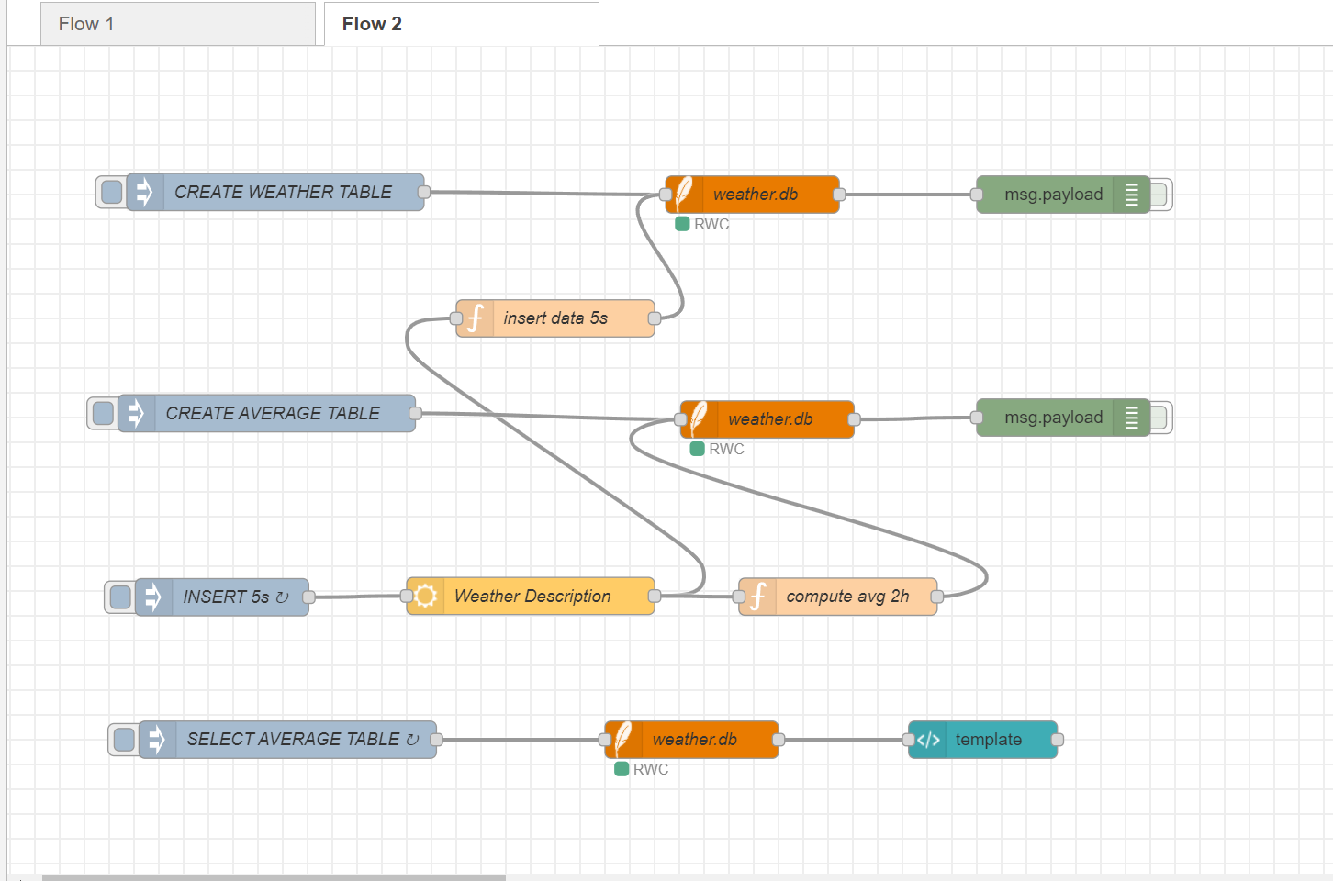
Flow 2

Slide 7
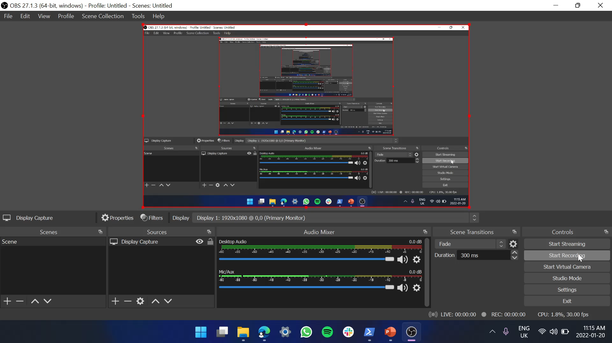
Recorded video

Slide 8
Node red installation and deploying the system
Install Node-Red
open a browser at the address http://127.0.0.1:1880/ , where the node-red MVC flow is.
Create the flows as mentioned in the previous slides.
Get the Api key from openweathermap.com
Enter the Api key in the flow
Deploy the Flows
In order to see the ui results of running the code you should open a browser tab at the address http://127.0.0.1:1880/ui/, where the dashboard is.

Slide 9
Modules used
The mοdules used in the application and need to be installed are listed below:
node-red-node-openweathermap
node-red-dashboard
node-red-node-sqlite

Slide 10
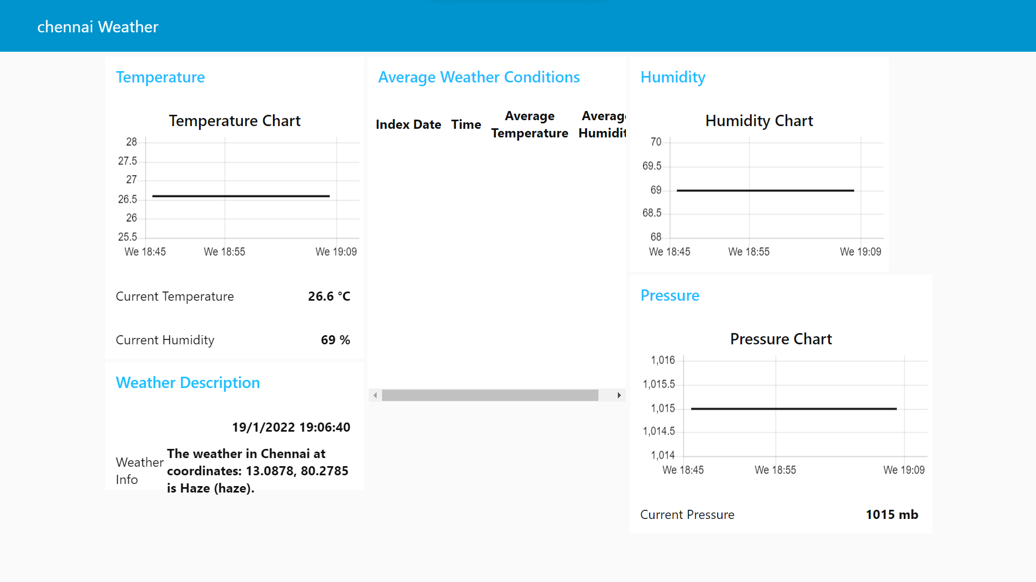
Dashboard

